Slide 1

Teacher Portal in C++
Teacher Portal for the calculation of total marks and grades of student

Slide 2
Overview of Project
File Handling:
The program reads student data from a CSV file, extracting information such as quiz and assignment marks, midterm, final exam, and project scores.
Weightage Configuration:
The teacher can set weightages for quizzes, assignments, midterm exams, final exams, and projects. This customization allows for flexible grading strategies.
Data Processing:
The portal processes student data to calculate quiz and assignment averages, considering the specified weightages. It also computes total marks for each student.
Grade Assignment:
Based on the calculated total marks, the program assigns grades to students using a predefined grading scale. This automates the grading process and ensures consistency.
User Interaction:
The portal offers user-friendly interaction options, allowing teachers to view class results on the console, generate a detailed CSV report, and search for an individual student by their roll number.
Overview and Analysis:
The system provides a comprehensive overview of class performance, displaying each student's name, roll number, quiz and assignment averages, total marks, and assigned grade.

Slide 3
Code Structure
Struct Definition:
struct student_data {
string name; string rollNumber; int quizzes[MAX_QUIZZES]; int assignments[MAX_ASSIGNMENTS]; int midterm; int finalExam; int project; double quiz_avg; double assignment_avg; int totalMarks; string grade;};
Functions Used:
- `student_count()`: Counts the number of students in the CSV file.
- `Weightage()`: Takes user input for weightages of quizzes, assignments, midterm, final, and project.
- `readDataFromFile()`: Reads student data from the CSV file and performs necessary calculations.
- `calculateClassAverage()`: Calculates the average total marks for the entire class.
- `assignGrades()`: Assigns grades to students based on their total marks.
- `generateResultsCSV()`: Writes the calculated results to an output CSV file.
- `searchStudent()`: Searches for a specific student by roll number and displays their detailed information.

Slide 4

Reading Data from CSV file
File Handling: Use ifstream to open and read data from the CSV file.
Data Extraction: Parse CSV lines to extract student details and scores.
Calculations: Compute averages, total marks, and specific weightages.
User Feedback: Display loading message for a user-friendly experience.
Code Section:
void readDataFromFile(const string& fileName, student_data students[], int numstudents, int weightages[], int quizCount, int assignmentCount, double& quiz_total, double& assignmnet_total, double& mids_total, double& final_total, double& project_total)

Slide 5
Weightages and Calculations
Understanding the weightages and calculating averages, total marks and grades
Reading weightages from the user
Calculating quiz and assignment averages
Total marks calculation with weightages

Slide 6
Results and Grades
Grade Assignment: Use a predefined scale to categorize students' performance.
Consistent Grading: Ensure fairness through a systematic grading approach.
Dynamic Grading: Grades dynamically adjust based on class average.
Individual Assessment: Every student's grade reflects their individual performance.

Slide 7
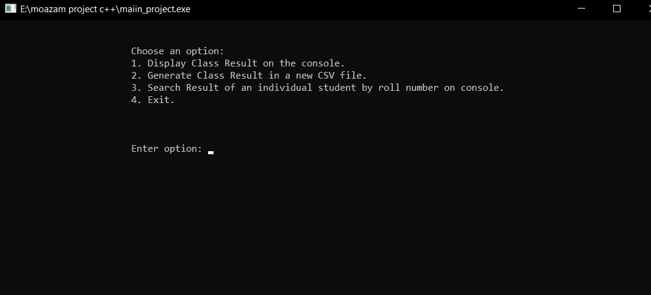
User Interaction

